Slide 1


Slide 2
Micro-reserving for Workers’ Compensation claims
a case study from Kaggle
© Boosted Goose (Nelvis Fornasin, Attila Gulyas)
This presentation has been prepared for the 2023 International Congress of Actuaries.
The Actuaries Institute Australia Council wishes it to be understood that opinions put forward herein are not necessarily those of the Institute and the Council is not responsible for those opinions.

Slide 3
The "Actuarial Loss Prediction" Competition
Duration: December 2020 to April 2021
Organizers: Actuaries Institute of Australia, Institute and Faculty of Actuaries and Singapore Actuarial Society
Platform: Kaggle
Objective: Prediction of workers' compensation reserves on an individual claim basis, i.e., development of an individual claim reserving model for IBNeR (Incurred but not enough Reported)
Data: Synthetically generated without reference to a specific jurisdiction or country. The dataset included, among other things, the insured person's anagraphic data, a description of the damage, and an initial estimate of the ultimate.
Evaluation of submitted solutions: Mean squared error (MSE)
Our result: 2nd place among the 140 participating teams/individuals

Slide 4
A quick overview of the data
Details on the insured person:
Age | Gender | Marital Status | Dependent Children
43 | M | F | 1
Details on the profession:
Weekly Wage | Part Time/Full Time | Hours Worked per Week | Days Worked per Week
509.34 | F | 37.5 | 5
Details on the claim:
Date and Time of Accident | Date Reported | Claim Description | Initial Incurred Costs
1999-01-07, 11:00:00 | 1999-01-20 | CUT ON SHARP EDGE CUT LEFT THUMB | 1500

Slide 5
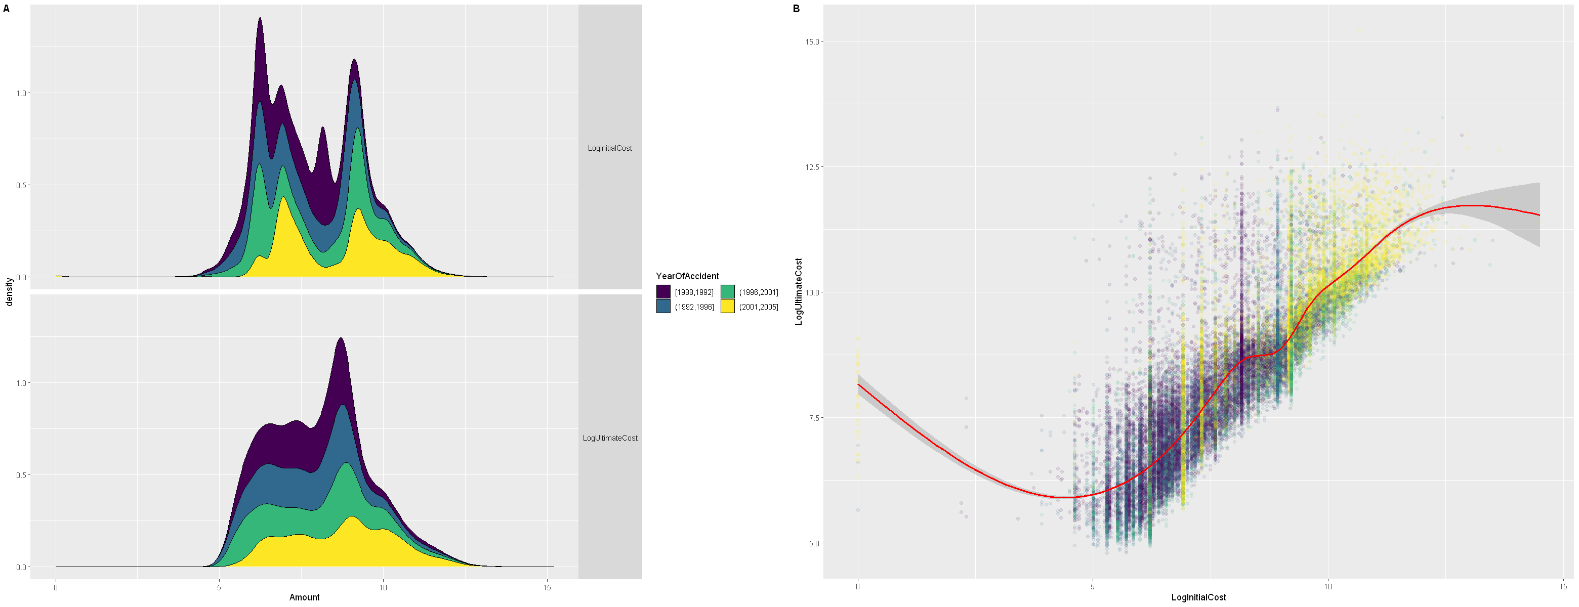
Initial vs. Ultimate Claim Cost

Slide 6
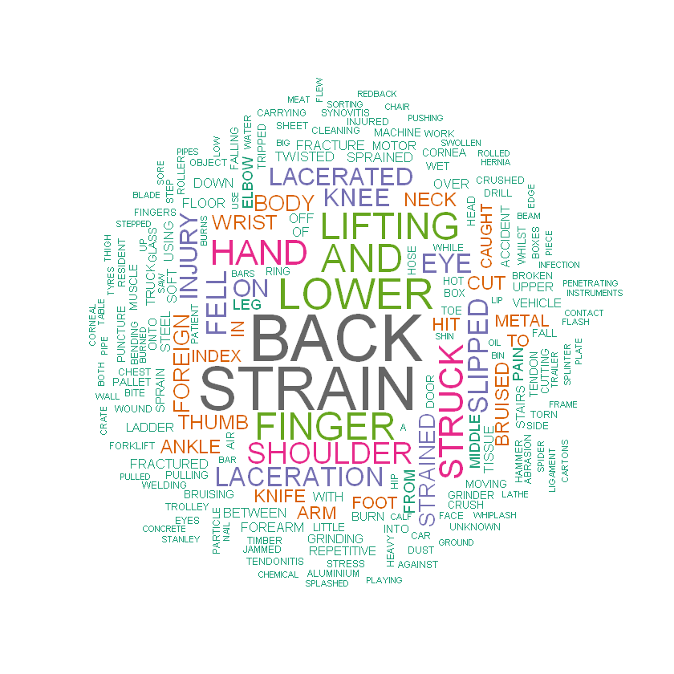
Claim Descriptions - Wordcloud
Remarks:
Many different words Synovitis, Table, Particle, Ring...
Body parts, types of accidents e.g. Back, Shoulder, Finger, Strain, Laceration
Important for the analysis:
Remove stop words e.g. and, to, with, on
Stem remaining words e.g. fall, falling, fell => fall
Cluster the stemmed words e.g. eye, cornea => "eye" cluster

Slide 7
Claim Descriptions - Effects on the ultimate
STEPPED ON ROCK RIGHT ANKLE
LIFTING A PATIENT BACK STRAIN

Slide 8
Claim Descriptions - Analysis
The (synthetically generated) claim descriptions don't offer much grammatical structure, sometimes simply nonsensical, e.g. "TO RIGHT LEG RIGHT KNEE".
• Our approach to analysis:
– Remove stop words ("in", "on", ...);
– Lemmatization and stemming of words ("Feet" and "foot" are both mapped to "foot", "laceration" and "lacerated" to "lacer");
– Clustering of words according to context and ultimate;
– OHE for the most common words.
• In the end, we OHEncoded about 100 words and created 30 clusters.

Slide 9
Some details on our model
Our algorithm consisted of the following ensemble methods:
• Boosting: Gradient boosting with xgboost
• Bagging: Random forest as base learner
• Voting: Combination of models based on expert estimates
Adjusting the following model parameters significantly improved our position on the leaderboard:
• num_parallel_tree: Setting this parameter to a number greater than 1 allows the use of Random Forest as the base model;
• monotone_constraints: This parameter can be used, for example, to enforce a positive relationship between the number of children and the ultimate;
• objective: Setting to reg:gamma and reg:tweedie.

Slide 10
Model comparisons
Takeaways:
Greatest impact is given by boosting
Without boosting:
NLP does not influence the results
Distribution-based loss functions perform significantly worse
Bagging does not consistently improve the result

Slide 11
Conclusion
Lessons learned:
• Feature engineering was more important than hyperparameter tuning;
• There is a Human Learning process which goes hand in hand with Machine Learning;
• Stacking models led to overfitting;
• Neural networks don't solve every problem.
• Large claims had a disproportionate impact on predictions (MSE).
Thank you for your attention!

